Slide 1

CSE 163
Hashing
Hunter Schafer

Slide 2
Week Agenda
Monday
Hashing
Wednesday
Exam Review
Thursday
Exam Review
Friday
Exam in class

Slide 3
Data Structures
List: Series of values, each with an index
list.append(v) O(1)
v in list O(n)
list[i] O(1)
Set: Collection of unique values, no sense of “order”
set.add(v) O(1)
v in set O(1)
set[i] Not allowed
Dictionary: Like a set, but maps distinct keys to values
dict[k] = v O(1)
k in dict O(1)
dict[k] O(1)
How can the set/dictionary have run-times that don’t depend on the number of elements in the data structure?

Slide 4
Hashing
The secret: Accessing an index in a list is fast
Sets/Dictionaries are just lists behind the scenes
Key ideas
Store a large list that is roomy (“hash table”)
Use a “hash function” to figure out the index for data
A hash function is a function that takes any arbitrary data and turns it into a fixed-sized value (i.e. a number)
We will focus on numbers as the data first

Slide 5
Set of Ints
Hash Function: h(v) = v % 10
nums = set()
nums.add(11) # 11 % 10 == 1
nums.add(49) # 49 % 10 == 9
nums.add(24) # 24 % 10 == 4
nums.add(7) # 7 % 10 == 7
print(49 in nums) # True
print(5 in nums) # False
0 |  | 0 | 0 |  | 0 | 0 |  | 0
0 | 1 | 2 | 3 | 4 | 5 | 6 | 7 | 8 | 9
0
0
24
0
11
7
49
0
What value could I add that breaks this?

Slide 6
Collision
This is nice and simple unless we get a collision
A collision is when two values hash to the same index
Impossible to avoid when our hash table has a fixed size
Two ways to make this work well in practice
Now: Have a way of dealing with collisions
Later: Come up with hash functions that avoid collisions as much as possible

Slide 7
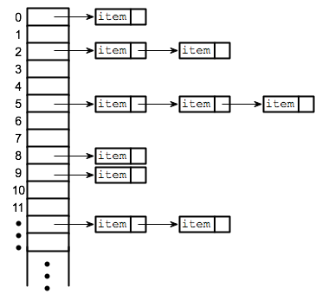
Chained Hashing
If we experience a collision, just store both values at that index
Under some reasonable assumptions, these buckets will be small compared to the size of the whole set of items
Care about the load-factor (num items / size of table)
If the load-factor is too high, these buckets will be big
Can rehash into a larger table to lower load-factor

Slide 8

1 min
If we do the insertions in the following order, what is the resulting hash table? Assume the following:
The hash table has 4 slots
If there is a collision, add the new value at front of the chain
We are using the hash function: h(v) = v % 4
nums = set()
nums.add(11)
nums.add(43)
nums.add(21)

Slide 9

2 min
If we do the insertions in the following order, what is the resulting hash table? Assume the following:
The hash table has 4 slots
If there is a collision, add the new value at front of the chain
We are using the hash function: h(v) = v % 4
nums = set()
nums.add(11)
nums.add(43)
nums.add(21)

Slide 10
Hash Functions
Our hash table can handle collisions, but we still want to keep the number of collisions low (otherwise buckets are large)
Integers are relatively easy to hash, but what about strings?
Each object can implement a __hash__(self) method
Write code to turn your object into an int
What makes a good hash function?
Needs to return a number
Should minimize the number of collisions
Should “look random” to maximize spread of values

Slide 11
Hashing Strings
Attempt #1: Use the length of the string
hash('') # 0
hash('hi') # 2
hash('abc') # 3
Is this a good hash function?
Easy to make collisions
Length of string is concentrated for most strings

Slide 12
Hashing Strings
Every character is represented by a number in the computer
ASCII: ‘ ‘=32, ..., ‘a’=97, ‘b’=98, …
Attempt #2: Add up the ASCII values for each character
hash('') # 0
hash('hi') # 104 (h) + 105 (i) = 209
hash('dog') # 97 (d) + 111 (o) + 103 (g) = 314
Is this a good hash function?
Definitely better than Attempt #1!
Is it easy to make a collision?

Slide 13
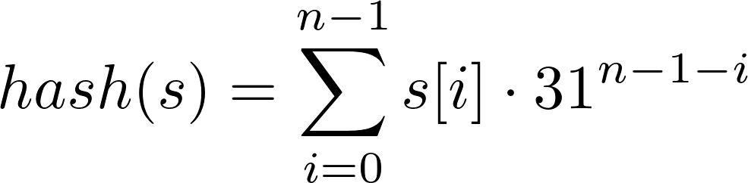
Hashing Strings
Last approach was good, but ignored crucial info: position
Instead of just summing the values, add information about position too
Many programming language (besides Python) use something like
Python’s is more complicated to avoid many real world attacks
Basic idea
Don’t throw information away

Slide 14
Hashing in Practice
Hashing and equality are deeply related
If two values are equal, they must hash to same value
If you implement __eq__ and __hash__, they need to be consistent
Generally, people let Python make a good hash function
class Example:
def __init__(self, a, b, c):
# Initialize _a, _b, _c
def __eq__(self, other):
return self._a == other._a \
and self._b = other._b
def __hash__(self):
return hash((self._a, self._b))

Slide 15
Brain Break

Slide 16
Hashing and Big Data
Hashing is one of the key techniques used to help us work with large datasets.
There are many different types of algorithms that scale that involve hashing (and many more that don’t!)
Today we are just going to focus on one that helps us count

Slide 17
Counting
At our start-up Schmoogle, we provide a search engine for the world to use.
We care a lot about our customer’s privacy, but we also care about money so we want to figure out what the most searched terms are in order to better monetize our website
Very simple way to track queries as they come in:
Store a dictionary with keys that are queries and values that are counts
How many keys would there be? Number of unique queries.
At Schmoogle this is fine, but does this approach scale to the scale of our main competitor, Google?
They get trillions of searches a year, 15% of which are brand new and never seen before
That’s a lot of keys

Slide 18
Count by Hash
Idea: Instead of storing all the queries, use a hash table that stores counts.
When a new query comes in (“dog”)
Hash it to find the index (4)
Increment the count at that index (77 -> 78)
Now to find the count for a query (“cat”)
Hash it to find the index (6)
Return that number (17)
Is the count of “cat” really 17?
14 | 302 | 94 | 124 | 77 | 400 | 17 | 0 | 19 | 43
0 | 1 | 2 | 3 | 4 | 5 | 6 | 7 | 8 | 9

Slide 19
Sketching
This technique is called a “sketch” of the data, it does not store all the data but lets us get the general idea
Answers will be approximations of the true values
Based on our counting scheme, the count we return is always an overestimate
It’s not possible to “miss” a count, but it is possible for a collision to overcount
Collisions cause error in the counts, so to avoid them
Use a bigger table
Use a better hash function
Very clever idea: Use multiple hash tables with multiple hash functions to reduce chance of collisions

Slide 20
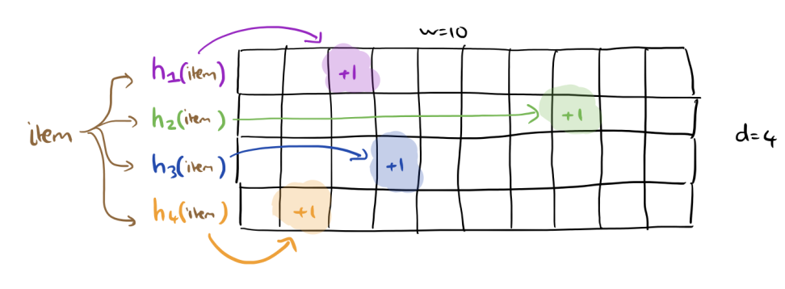
Count-Min Sketch
Use d hash tables of size w with different hash functions
Every time an item comes in, increment the count in each table
Even if two values collide in table 1, it’s unlikely they collide in table 2, 3, or 4!

Slide 21
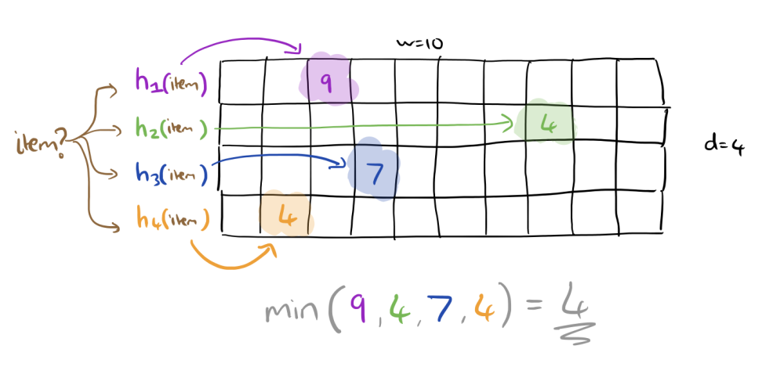
Count-Min Sketch
When we receive an item we look it up in all tables
What result should we return?

Slide 22
Count-Min Sketch
You can use this if the actual count is not of critical importance, but rather the rough idea is good enough
Good for page views, bad for counting payments
You can’t use this if the values can ever decrease
Much better in terms of space!
A plain old hash-table needs O(n) space
The count-min-sketch needs O(wd) which can be much much smaller than n
You can get provable guarantees on how large the error is or how big to make w and d, but the math can be pretty advanced
Challenge: You can read more here

Slide 23
Recap
Important idea: Turn a value into something like a number and put it in a table
We want to avoid collisions by using a good hash function, but they are inevitable so we must build in a way to handle them
Applications of hashing
“Instant” lookup for sets/dictionaries
Approximate counts
Much much more!
Cryptography
Approximate nearest-neighbor
I don’t want you to be able to implement a hash table from scratch, but I do want you to be able to understand the big idea

